Slide 1
Aqidah – Lesson 2

Slide 2
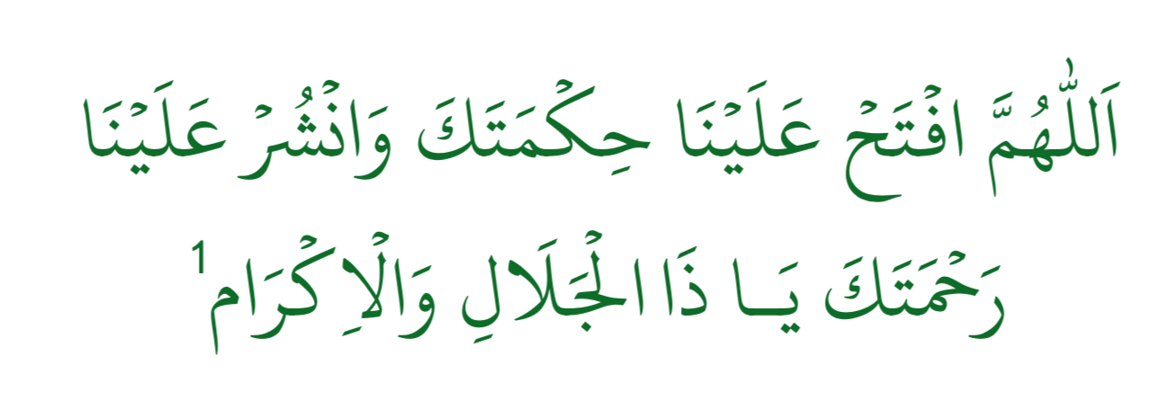
Du’a for having excellent memory
Translation: O Allah! Open the door of knowledge and wisdom for us and have mercy upon us! O the Greatest and the Holiest!

Slide 3
Recap – Lesson 1
Imaan
Kufr
Shirk
Wajib ul Wujood
Murtad

Slide 4
Keywords
Muhaal – impossible
Zaat – Divine self
Sifaat – Divine attributes
Qadeem – Always existed
Azali/Abadi – Will always continue to exist
Haadith – a thing which will finish everything apart from Allah and his attributes is Haadith.

Slide 5
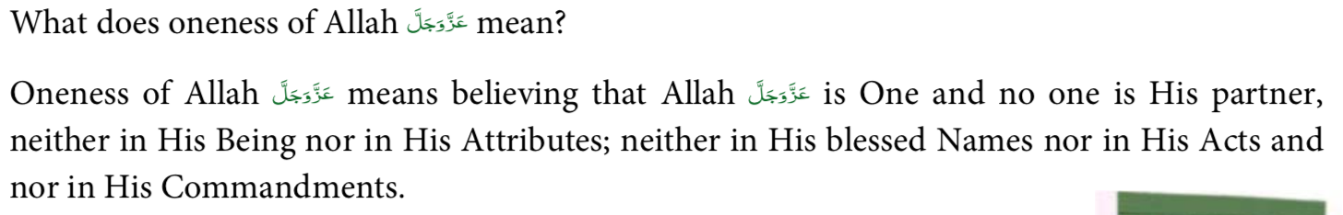
Oneness of Allah

Slide 6
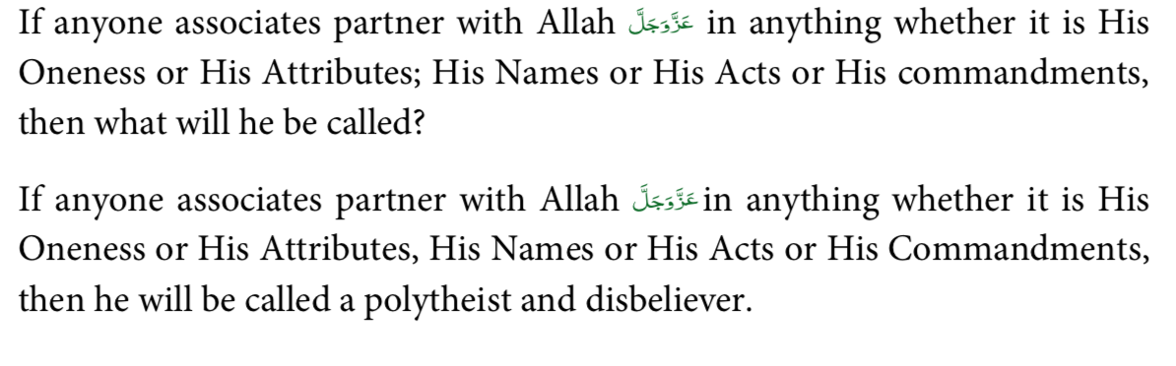
Associating partners with Allah

Slide 7
Beliefs about Allah
Almighty Allah is ‘Waajib ul Wajood’ - His existence is necessary and His non-existence is Muhaal (impossible).
Almighty Allah is Qadeem - He has always existed.
He is Azali and Abadi - He will continue to exist.
Allah Alone is worthy of being Worshipped

Slide 8
Beliefs about Allah - continued
Trying to understand Almighty Allah’s Zaat (Divine Self) by means of reason and intellect is absolutely impossible.
There is nothing that can enclose or comprehend Allah’s Divine Self
Through Almighty Allah’s Doings (Af’aal) His Attributes can be recognised and, one is able to know about Almighty Allah’s Zaat
With the exception of Almighty Allah’s Being (Zaat) and Attributes (Sifaat), everything else is known as Haadith. ‘Haadith’ means that everything besides Allah’s Divine Being and Attributes were non existent

Slide 9
Beliefs about Allah - continued
Allah is neither, the father or son of anyone, and nor does He have any wife. Anyone who claims that Allah is the father or son of anyone, or says that Allah has a wife, is an unbeliever(kaafir). Even, if one considers this to be a possibility, he is misguided.
If Jesus was the son of God (Allah) because he has no father? Wouldn’t that rank Hazrat Adam higher because he has no mother OR father?
Allah is Free from anything which is ‘Muhaal’ (absolutely impossible)
It cannot be connected to Him because ‘Muhaal’ refers to that which can never exist.
To say that He has the ability of lying, in the sense that he can tell a lie, is to declare a Muhaal (absolutely impossible) to be Mumkin (possible) and to imply that Almighty Allah has defect. This, in reality is to reject Almighty Allah.v

Slide 10
Beliefs about Allah - continued
Belief: Existence, Divine Power, Divine Hearing, Divine Seeing, Divine Speech (Kalaam), Divine Knowledge and Divine Will are all His Self Attributes.
He does not depend on ears, eyes and tongue to hear, see or speak, as these are all physical (i.e. belonging to a body) and
Allah is free from any physical form and body.
He hears the faintest of sounds and sees the smallest of things, even that which cannot be seen under the lenses of a microscope.
His seeing and hearing is not only confined to this but He is all Seeing and All Hearing.
We thus say that Allah sees absolutely and hears absolutely.

Slide 11
Beliefs about Allah - continued
In reality, it is Allah who sends down sustenance. The Angels etc. are only means and channels for delivering the sustenance etc.
He knows everything, be it manifest or hidden. Ilm-e-Zaati (Divine Self-Knowledge) is His unique Attribute. Any person, who tries to prove Ilm-e-Zaati, be it of manifest or hidden things, for any but Allah, is an unbeliever.
He is Qaadir (has Divine Power) over everything that is possible (Mumkin). There is nothing possible that is out of his Power.

Slide 12
Where is Allah?

Slide 13
Where is Allah?
Allah almighty is free from time and space.
Because time and space is also a creation and we cannot asssociate the Zaat of Allah with something that is created.
If we were to say Allah is everywhere, it would imply He is also in the impure and bad places of the world.
In terms of His power and attributes, He is everywhere.

Slide 14
Questions
What is Imaan?
What is Kufr?
Name 3 essentials of Imaan?
What does one become by denying beliefs of the Ahlus Sunnah?
What does Shirk mean?
What is the defintion of a Murtad?

